Slide 1
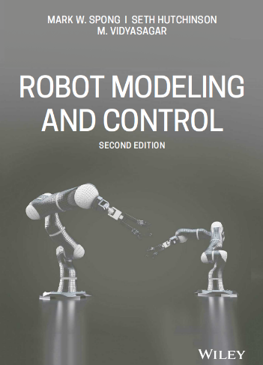
Welcome Everyone to
MECH 641/EECE 661 – Robotics
Hussein Hussein,
Bechtel 503
email: hh224@aub.edu.lb
Office hours: TR 13:00-15:00 - by appointment
Unit of Study Description
Classes: 2 lectures, 1h 15m each
Time: TR 15:30 - 16:45
Place: Bechtel 208
Lab: 1 session, 3h
Time: TR 17:00 - 19:45
Place: Oxy 402
Pre- or Co-requisite: Control systems

Slide 2
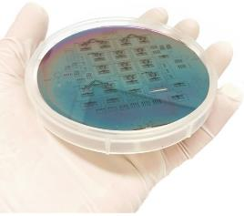
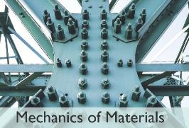
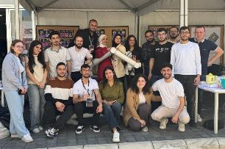
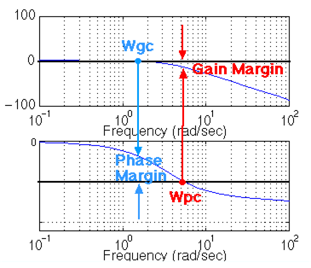
Teaching at AUB
Fall 22/23
Mech 631
Micro-electo mechanical systems (Mems)
Spring 22/23 -/24 -/25 -/26
Mech 320
Mechanics of materials
Fall 23/24 - 25/26
Mech 230
Dynamics
Fall 23/24
Spring 22/23 -/24 -/25 -/26
Mech 641/ EECE 661
Robotics
Engineering Mechanics
Dynamics
R. C. Hibbeler
Fall 25/26
Mech 436
Control

Slide 3
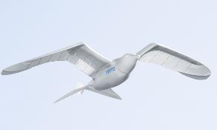
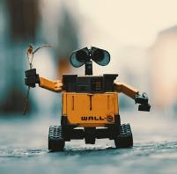
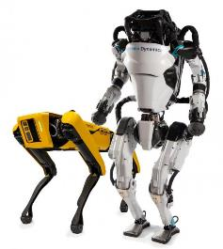
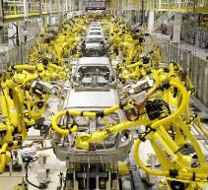
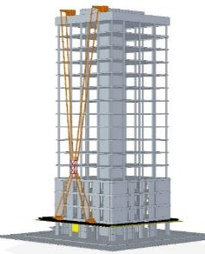
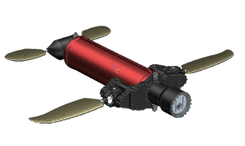
Robotics
A robot is a machine capable of carrying out a complex series of actions automatically
Robotics is the interdisciplinary branch of engineering and science that deals with the design, construction, operation, and use of robots
Imitation of manual actions by humans to replace it for highly repetitive tasks in the industry.
Using of robots for automated tasks:
increased the human performance capacity
enhanced the cost, quality and delivery time for different tasks and products.
Robotics investigates how robots can be used to:
automate tasks
improve efficiency in various industries such as manufacturing, healthcare, and transportation.

Slide 4
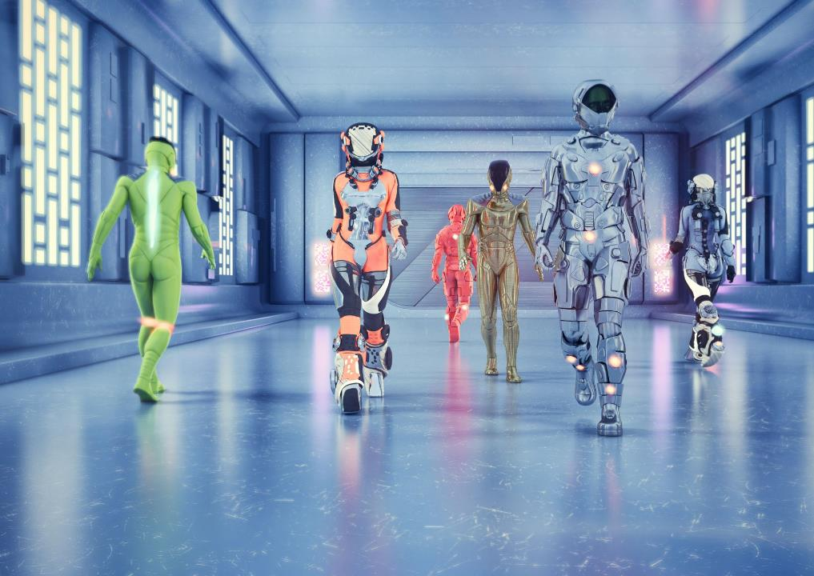
Why robots?
Robotics is the science of making machines do what humans used to do
Robots are good for the 3 Ds: jobs that are dirty, dull, or dangerous.
To date, robots have been used to:
replace or substitute for humans
Service
Medicine
assist humans
amuse.
Robots are revolutionizing the way we approach everyday tasks.
The possibilities of Robotics are endless, Robotics is the future!
Notes:
With the knowledge we will gain in this class, we will have the tools to design and create robots that can improve efficiency and push the boundaries of what is possible. I am excited to embark on this journey with you and to see the incredible things we will be able to accomplish together."

Slide 5
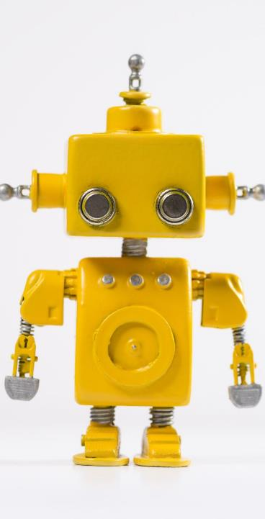
A brief history of Robotics

Slide 6
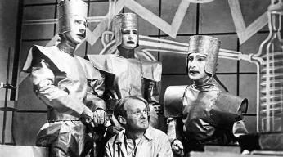
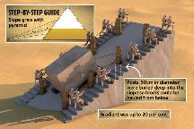
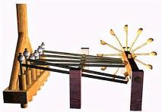
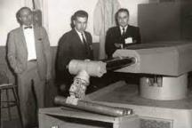
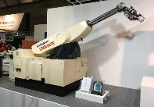
A brief history of Robotics
The word “robot” came into the popular consciousness on 1921, in Prague, with the first performance of Karel Capek’s play, R.U.R. (Rossum’s Universal Robots).
The history of robotics can be traced back to ancient times, with the invention of simple machines such as the pulley and lever.
240-year-old drawing robots (Link)
The modern robotics began to take shape in the 20th century with the advent of electronics and computers.
In the 1940s and 1950s, scientists and engineers began to explore the idea of using machines to automate tasks that are traditionally done by humans.
1954: first patent for an industrial robot.
1961: the first industrial robot was installed in a General Motors factory.
R.U.R. performance, 1921
Pyramid construction 2550 BC
Taqi Al-Deen’s Pump 1551 AD
First industrial robot, 1961

Slide 7
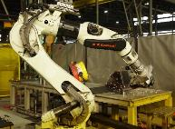
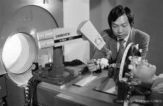
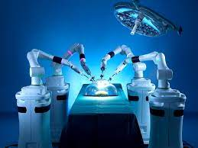
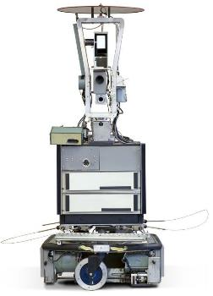
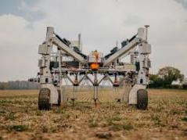
A brief history of Robotics
In the 1970s and 1980s, robotics continued to advance
more sophisticated sensors and control systems.
Robotics began to be used in a wide range of industries, including manufacturing, agriculture, and construction.
1977, the first robot with six-axis of freedom was developed by Kawasaki Heavy Industries.
In the late 1980s,
mobile robots began to emerge, with the development of robots that could move around in the environment.
first mobile robots were used in manufacturing and logistics, but they soon found applications in other fields such as mining, agriculture, and even space exploration.
In the 1990s, robots began to be used in
more advanced applications, such as in surgery, where robotic arms were used to perform delicate procedures.
The use of robots in surgery has grown significantly and it's now considered the standard of care for many procedures.

Slide 8
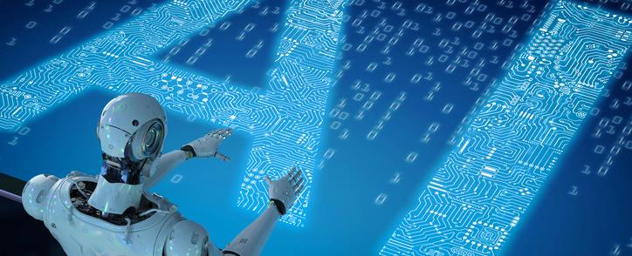
In the 21st century, Robotics has seen a rapid development, with the advent of advanced technologies like artificial intelligence and machine learning.
Expanding beyond the industry and factory, with more and more robots being used in healthcare, services, and even in domestic environments.
More accessible and affordable, with the rise of DIY robots and the development of low-cost robotic platforms.
Robotics is now considered to be a key technology for the future and it is expected to play a major role in many areas of our lives.
The field of Robotics is constantly evolving and advancing, and it's an exciting time to be a part of it.
A brief history of Robotics

Slide 9
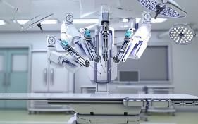
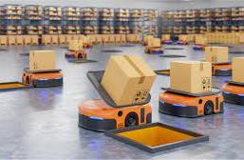
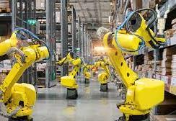
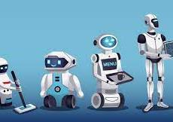
Most common types of robots
1 - Industrial robots:
used in manufacturing, assembly, and other applications.
perform repetitive tasks with high precision and speed.
larger and more expensive than other types and used in large factories or industrial settings.
2 - Service robots:
interact with people and provide a service.
found in hospitals, hotels, and airports.
tasks such as cleaning, security, and customer service.
3 - Mobile robots:
can move around in their environment
wide range of applications, such as logistics, agriculture, mining, and space exploration.
autonomous or teleoperated, and they can be either ground-based, in water or aerial.
4 - Medical robots:
assist with surgeries, therapy, and other procedures.
tasks such as performing minimally invasive procedures, assisting with rehabilitation, and monitoring patients.

Slide 10
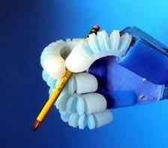
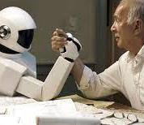
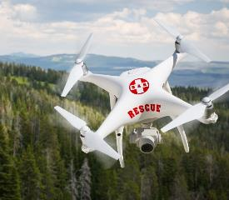
Most common types of robots
5 - Social robots:
interact with humans in a social manner
tasks such as companionship, education, and entertainment.
6 - Drones:
fly and navigate autonomously
tasks such as delivery, surveillance, mapping, and inspection.
7 - Soft robots:
made of soft and flexible materials
used in areas where traditional robots can't go, such as in delicate environments, or interacting with humans.
These are also many other specialized robots that are used in specific applications.
As technology continues to advance, the types of robots and the applications for them will continue to expand and evolve.

Slide 11
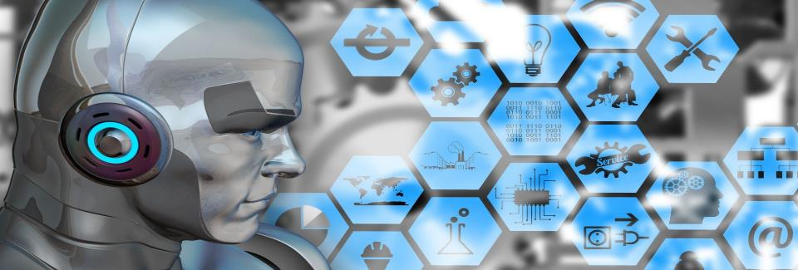
The future of robotics is expected to be very exciting and dynamic.
development of new technologies and applications
potential to revolutionize the way we live and work.
One of the most important areas of growth for robotics is in the field of artificial intelligence (AI). Advances in AI enable robots to perform tasks that were previously thought to be the exclusive domain of humans. This include things like natural language processing, image recognition, and decision-making.
Another area of growth for robotics is in the field of autonomous systems, such as self-driving cars and drones, which have the potential to greatly improve efficiency and safety in transportation, logistics, and other industries.
Robotics will also have a significant impact in the field of healthcare, with the development of new robotic surgical systems, telemedicine robots, and other assistive technologies that will help to improve the quality of care and the lives of patients.
Future of robotics

Slide 12
Robots and automation will continue to play an important role in manufacturing and industry, with the use of robots in factories, warehouses, and other industrial settings.
Overall, the future of robotics is very promising, with the potential to greatly improve efficiency, safety and quality of life in many industries.
It's an exciting time to be a part of the field of robotics and to see how it will continue to shape our world in the future
Future of robotics

Slide 13
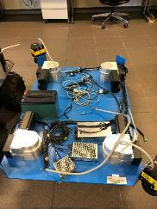
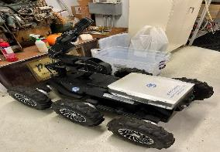
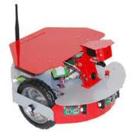
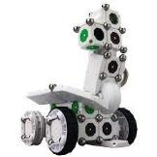
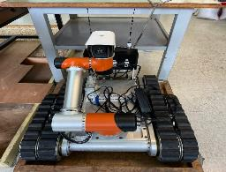
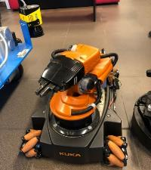
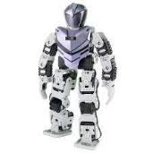
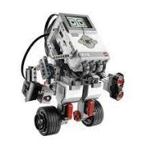
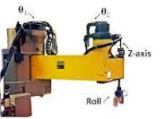
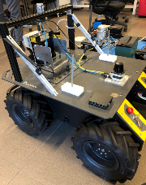
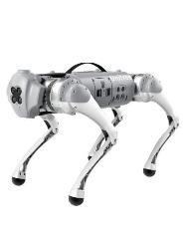
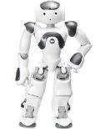
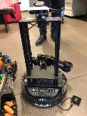
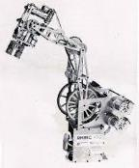
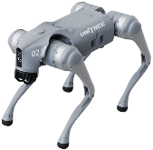
Robots at AUB
Dr Robot X80
Exofabulatronixx 5200
BMW AG
Robotis Premium
Mindstorms EV3
IBM SCARA 7540
Kuka Youbot
Nao Robot
Kobuki
Rhino
Husky
Unitree Go1
Unitree Go2

Slide 14
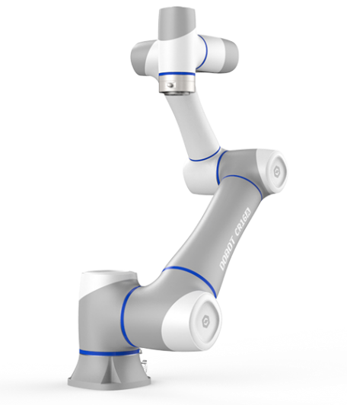
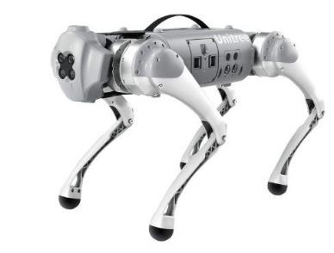

Robots for the Robotics lab
Dobot CRA10 and Unitree Go1 & Go2

Slide 15
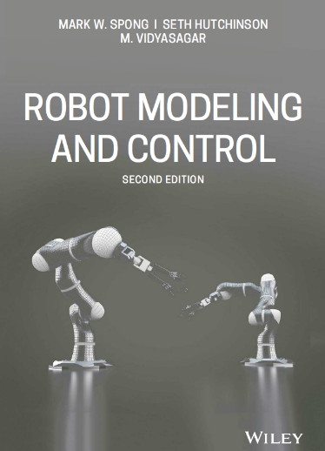
Syllabus
Textbook
M.W. Spong, S. Hutchinson and M. Vidyasagar. "Robot Modeling and Control", John Wiley, Second edition, 2018
Class Meetings and Office Hours
LEC: | TUE & THU | 3:30 pm – 4:45 pm | BECHTEL 208
LAB: | TUE or THU | 5:00 pm – 7:45 pm | IOEC 402
OH: | TUE & THU: | 01:00 pm – 03:00 pm | BECH 503
Personnel
Lecturer: Hussien Hussein (Bechtel 503–hh224@aub.edu.lb)
Lab instructor: Samer Bou Karam (IOEC 411–sb137@aub.edu.lb)

Slide 16

What is this course about?
We want robot arms (typically serial manipulator) do some desired task. To accomplish this, one needs to be well versed in the following topics
Robot modeling
Kinematics
Dynamics
Planning
Motion planning
Trajectory generation
Control
Traversing a trajectory
Motor controller for joints

Slide 17


Robot modeling
Kinematics: is the study of motion without a regard to forces.
🞄 Knowing the geometry of the links and the type of the joints are enough to locate any point on the robot
Dynamics: is the study of motion considering the effect of forces on a mechanical system
🞄 Knowing the mass and inertia of the links, the motion of the robotic system can be described provided that one knows the external forces acting on the robot.

Slide 18
Planning
Motion planning: path
🞄 Formalizing the task of the robot, such as, going from a start to a goal location (fastest time, least control energy, etc.)
Trajectory generation: path + schedule
🞄 Formalizing how to connect two configurations, how the robot should proceed from a start to a goal

Slide 19
Control
Traversing a trajectory:
🞄 Finding the motor angles that make the end effector or a robot traverse a trajectory
Motor controller for a joint:
🞄 Finding the motor input that makes a motor angle maintain a certain value or follow a prescribed function of time.

Slide 20




Lab sessions
Labs span topics such as:
Working with Ros 2 on Ubuntu
Building functional Ros applications
Using Ros packages (Rviz, gazebo)
Advanced project including application of the student solutions on the robotic arm platform and Unitree Go1 and Go2
Use LLM for robots decision making

Slide 21


Slide 22
Course Outline
Topic | Learning Activities | Due Dates
Introduction to Robotics (Chapter 1) | Lecture | 1 week
Rigid Motions (Chapter 2) | Lecture, Homework | 2 weeks
Forward Kinematics (Chapter 3) | Lecture | 2 weeks
Jacobians (Chapter 4) | Lecture | 3 weeks
Inverse Kinematics (Chapter 5) | Lecture | 1 week
Dynamics (Chapter 6) | Lecture, Homework | 2 weeks
Motion Planning and Trajectory Generation (Chapter 7) | Lecture, Homework | 1 week
Topic | Due Dates
Lab Project 1: ROS Nodes to control a Robot | Half of the semester
Lab Project 2: Control robots in Ros for a cooperative application | End of the semester

Slide 23
Grading
weeks | Tuesday | Thursday
1 | 13-Jan | 15-Jan
2 | 20-Jan | 22-Jan
3 | 27-Jan | 29-Jan
4 | 3-Feb | 5-Feb
5 | 10-Feb | 12-Feb
6 | 17-Feb | 19-Feb
7 | 24-Feb | 26-Feb
8 | 3-Mar | 5-Mar
9 | 10-Mar | 12-Mar
10 | 17-Mar | 19-Mar
11 | 24-Mar | 26-Mar
12 | 31-Mar | 2-Apr
13 | 7-Apr | 9-Apr
14 | 14-Apr | 16-Apr
15 | 21-Apr | 23-Apr
16 | 29-Apr
Assessment
Team quizzes and activities | 10%
Midterm | 20%
Lab project | 25%
Final | 45%
Midterm: Chapters 2, 3, and 4
Final: DH + Chapters 4, 5 and 6
Forum
Presentation/Video Segment
Matlab-based assignments and exams
Team assignments and quizzes

Slide 24

Team formation
Team formation
2-3 members per team
Choose your teams on Moodle
Grading
Grades will be over 10 pts
First 3 teams will have 1,2 and 3 extra points on the total

Slide 25
Office hours
 | MONDAY | TUESDAY | WEDNESDAY | THURSDAY | FRIDAY
08:00 - 09:00
09:00 - 10:00
 |  | Mechanics of Materials |  | Mechanics of Materials
10:00 - 11:00
11:00 - 12:00
12:00 - 13:00
13:00 - 14:00 |  | Office Hours |  | Office Hours
14:00 - 15:00
15:00 - 16:00
 |  | Robotics |  | Robotics
16:00 - 17:00 |  | Robotics |  | Robotics
 |  | Robotics |  | Robotics
hh224@aub.edu.lb
Bechtel 503

Slide 26

Do you want to make some nice research?
In Mechanics, Mechatronics, and Microsystems
Hussein Hussein
hh224@aub.edu.b
Bechtel 503 Ext: 3687

